Slide 1


[Title]

Slide 2


Today's agenda
Project recap
Problem
The Analytics team
Process
Insights
Summary

Slide 3

Social Buzz is a fast-growing technology unicorn that needs to adapt quickly to its global scale
Accenture has begun a 3 month POC focusing on this task:
An Audit of Social Buzz Big Data practice
Recommendations for a Successful IPO
Analysis to find Social Buzz's top 5 most popular categories of content
Project Recap

Slide 4


Problem
Over 100000 posts per day
36,500,000 pieces of content per year!
But how to capitalize on it when there is so much?
Analysis to find Social Buzz top 5 most popular categories of content

Slide 5



Akinbowale Micheal
Data Analyst
The Analytics team
Marcus Rompton
Senior Principal
Andrew Flemming
Chief Technical Architect

Slide 6
Data Understanding
Process
1
2
Data Cleaning
3
Data Modelling
Data Analysis
4
5
Uncover Insights

Slide 7

Insights
16
1897
MAY
UNIQUE CATEGORIES
REACTIONS TO ”ANIMAL” POSTS
MONTH WITH MOST POSTS

Slide 8
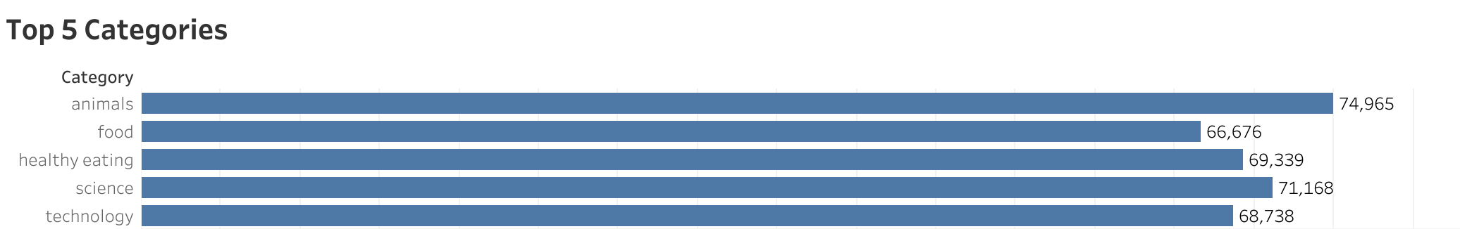

Slide 9
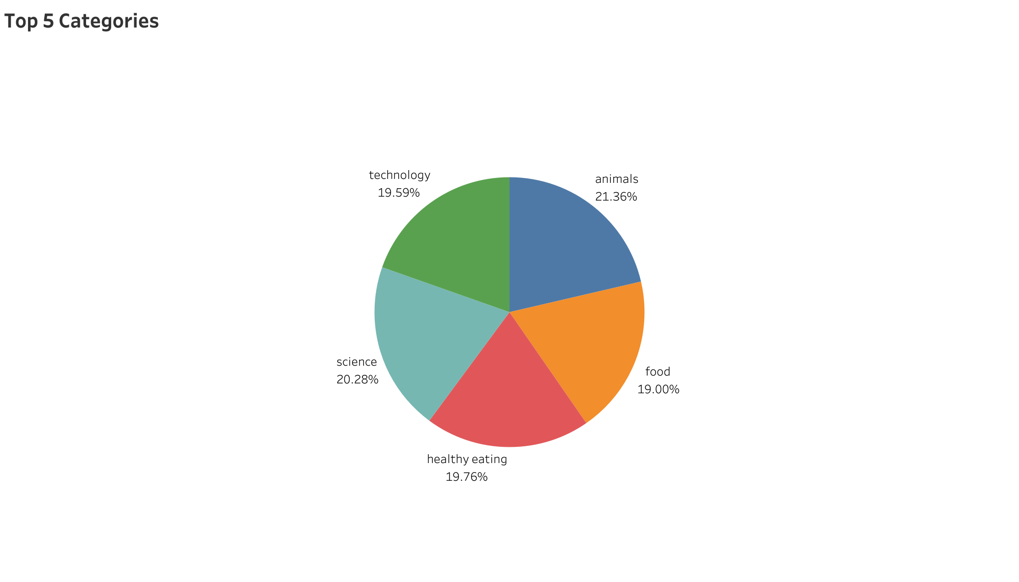

Slide 10

ANALYSIS
Animal and Science are the most two popular categories of content, showing that people enjoy ”real-life” and “factual” content the most
INSIGHTS
Food is a common theme with the top 5 categories with “Healthy Eating” ranking the highest. This may indicate the audience within your user base. You could use this insight to create a campaign and work with healthy eating brands to boost user engagement
Summary
NEXT STEPS
This ad-hoc analysis is insightful, but it is time to take this analysis into large-scale production for a real-time understanding of your business. We can will show you how to do this

Slide 11

Thank you!
ANY QUESTIONS?

